Slide 1


Slide 2

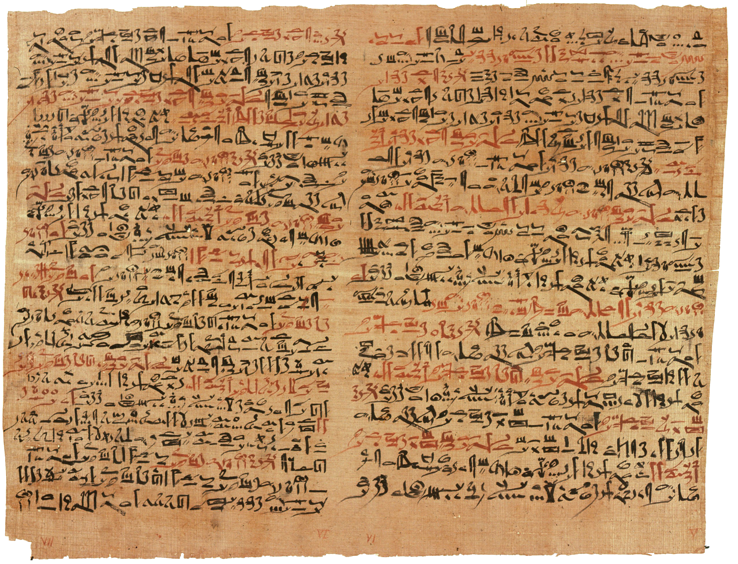
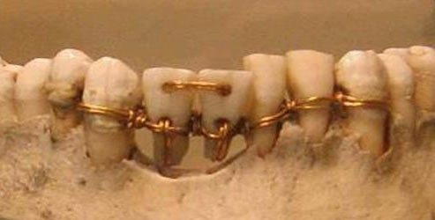
Egyptian Dental Bridgework
More than one example of ancient Egyptian dentistry has been found on mummies from this time period.
The Edwin Smith Papyrus (c. 1600 BCE)
An Egyptian medical textbook. Contains similarities to the empirical method of science.

Slide 3
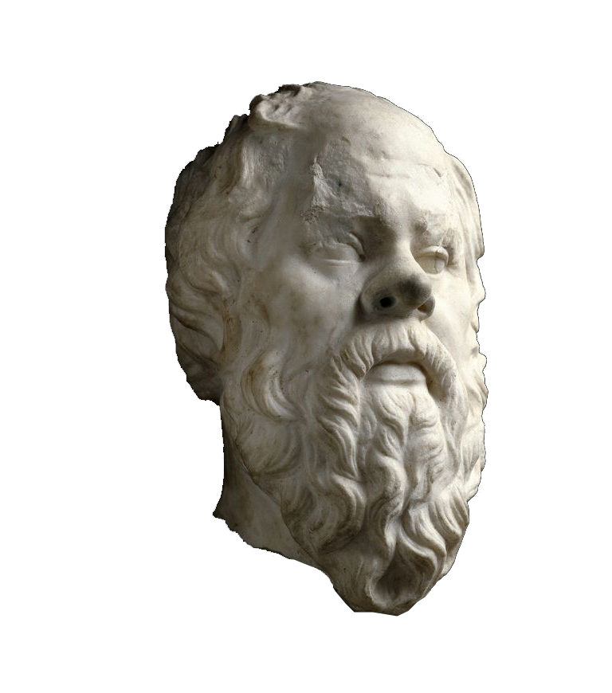

One of the founders of Western philosophy. He made no writings of his own; most of what we know about Socrates, we have learned from the writings of his students.
The Socratic Method, a method of dialog intended to stimulate critical thinking, bears his name.
Socrates
(c. 470 – 399 BCE)

Slide 4
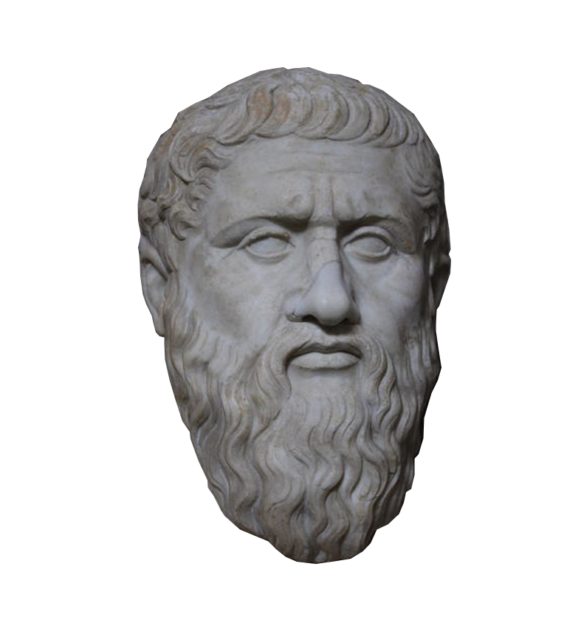
A student of Socrates, Plato is considered the founder of Western political philosophy. A prolific writer, nearly all of Plato’s works have survived to this day.
In addition to Socrates, was also influenced by earlier philosophers such as Pythagoras. He notably supported Pythagoras’ philosophy of rationalism.
Rationalism
The belief that human reason is the chief source and test of knowledge.
Plato
(c. 428 – 347 BCE)

Slide 5
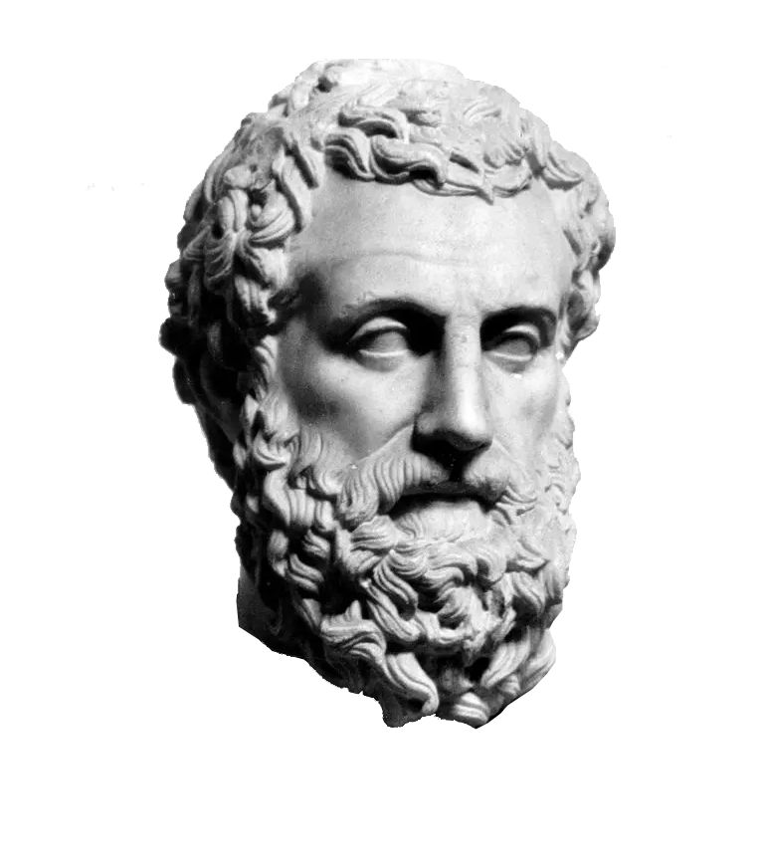
A student of Plato, Aristotle’s views on physical science had a profound historical impact. His works include writings in physics, biology, zoology, metaphysics, logic, psychology, linguistics, ethics, politics, and art.
Unlike his teacher, Aristotle was a champion of the philosophy of empiricism. The concept of the human mind as a tabula rasa (“clean slate”) which records experiences dates back to the writings of Aristotle.
Empiricism
The belief that knowledge comes primarily from sensory experience.
Aristotle
(c. 384 – 322 BCE)

Slide 6
Rationalism
The belief that human reason is the chief source and test of knowledge.
Belief that the world is an imperfect representation of a perfect ideal, and only pure thought can reveal those ideals.
Empiricism
The belief that knowledge comes primarily from sensory experience.
Belief that the human mind contains no innate thoughts; all our thoughts are informed from our sensory experience.

Slide 7
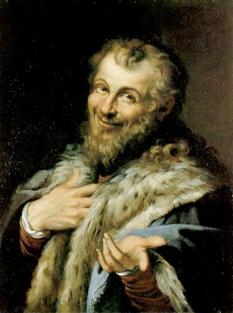




Rationalism Being Right – The Proposal of the Atom
Around 460 BCE, the Greek philosopher Democritus posed a question:
If you break an object in half, then break those halves in half, then continue breaking those objects in half indefinitely, how many breaks would you have to make before the object could not be divided any further?
?

Slide 8
Rationalism Being Right – The Proposal of the Atom
Around 460 BCE, the Greek philosopher Democritus posed a question:
If you break an object in half, then break those halves in half, then continue breaking those objects in half indefinitely, how many breaks would you have to make before the object could not be divided any further?
Democritus believed that there would be a point where you reached the smallest possible bit of matter. He referred to these particles as “atoms”.
Although this conclusion was correct, it was over 2000 years before this question could be seriously considered scientifically.

Slide 9





Rationalism Being Wrong – The Platonic Solids
There are a total of five regular, convex polyhedrons that can be arranged in three-dimensional space (solids constructed from regular polygons, with the same number of polygons meeting at each vertex).
Tetrahedron
(4 faces)
Cube
(6 faces)
Octahedron
(8 faces)
Icosahedron
(20 faces)
Dodecahedron
(12 faces)
Plato felt that these so-called “perfect” solids must make up the fabric of reality. He connected them to the particles proposed by Democritus…

Slide 10

Rationalism Being Wrong – The Platonic Solids
Due to their number, Plato logically prescribed four of these to the four classical elements of antiquity.
Tetrahedron
(4 faces)
Cube
(6 faces)
Octahedron
(8 faces)
Icosahedron
(20 faces)
Dodecahedron
(12 faces)
“Fire”
“Earth”
“Air”
“Water”
“The Heavens / Aether”

Slide 11
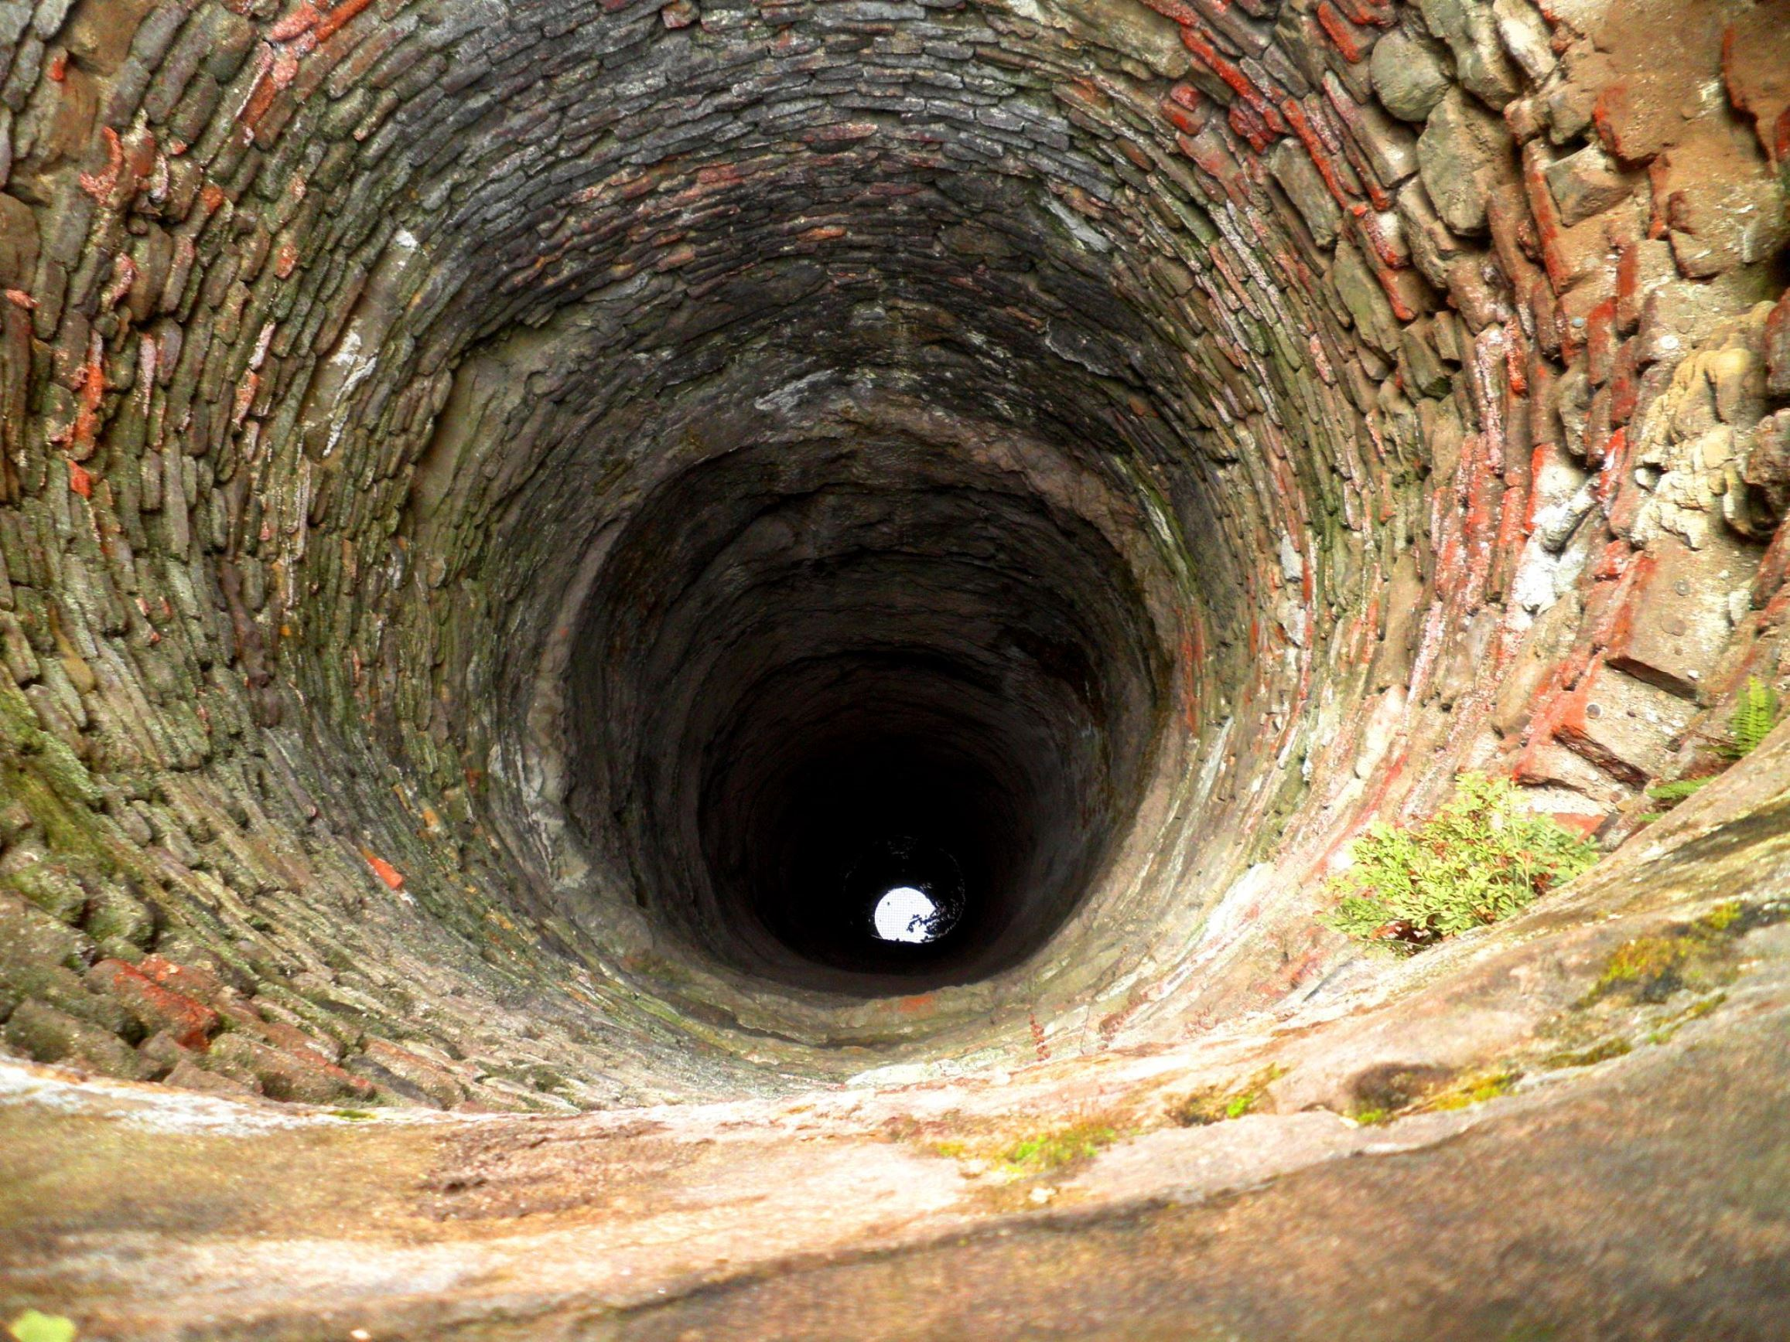
Empiricism Being Right – The Diameter of the Earth
In the 3rd century BCE, Eratosthenes of Cyrene, a Greek scientist and mathematician, noted reports that the bottom of a well in the Egyptian city of Syene was illuminated only at noon on the summer solstice, indicating that the sun was directly overhead that city.
He also noted that this was not the case in his own city of Alexandria.

Slide 12
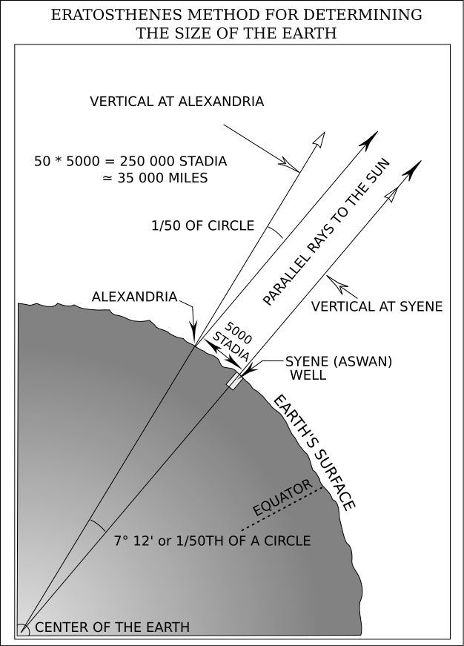
Empiricism Being Right – The Diameter of the Earth
Eratosthenes measured shadows to experimentally determine the angle of the sun in both cities. Using the assumption that the earth is a sphere, as well as geographical information regarding the distance between the two cities, Eratosthenes calculated the circumference of the earth.
His calculation was accurate to within 16.3% of the value known today.

Slide 13
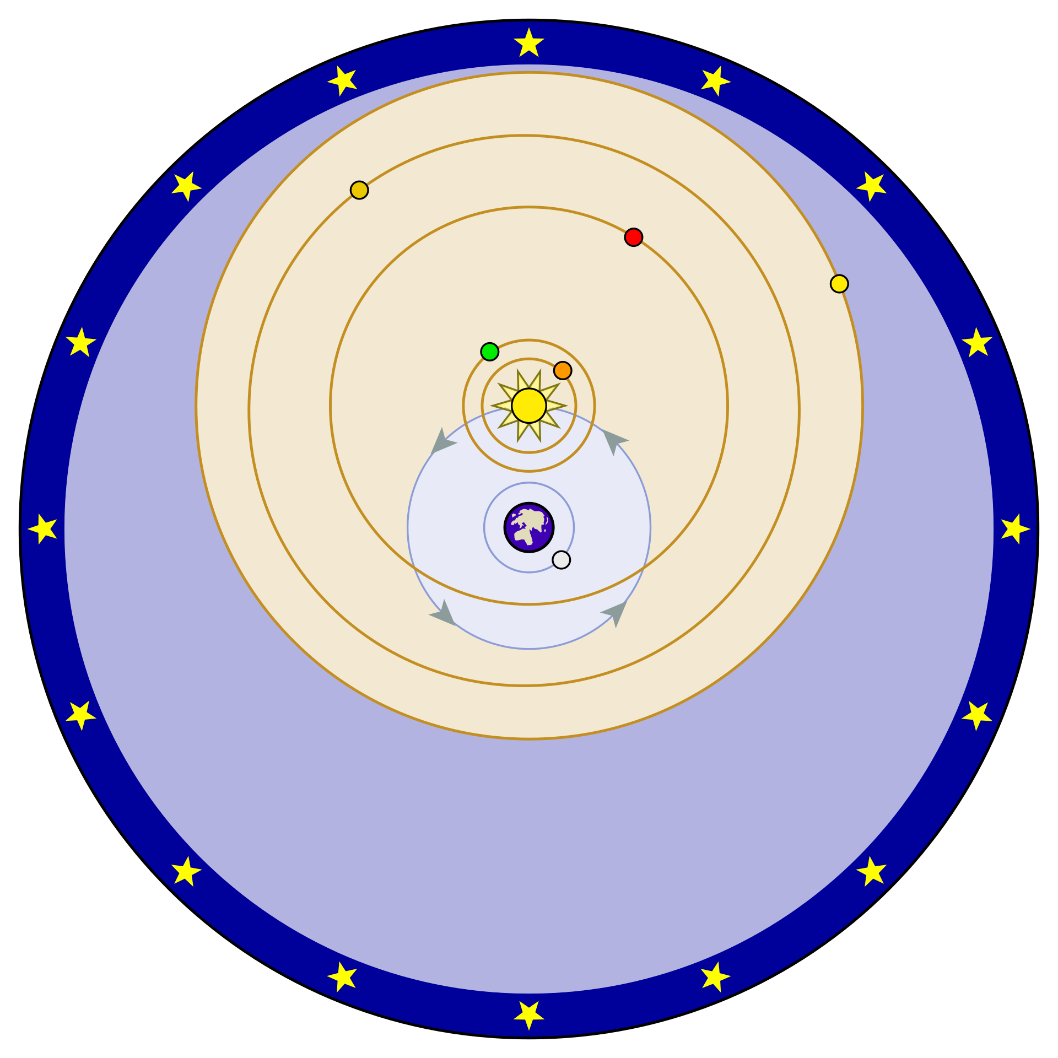
Empiricism Being Wrong – The Geocentric Universe
Although it holds no truth, the geocentric model of the universe is rooted in empiricism. Two observations support this idea:
The sun appears to revolve around the Earth at the same rate no matter where you are on Earth. Other planets have their own motions, but also appear to revolve around the Earth once per day.
Earth seems to be unmoving from the perspective of a person on its surface; it feels solid, stable, and stationary.

Slide 14
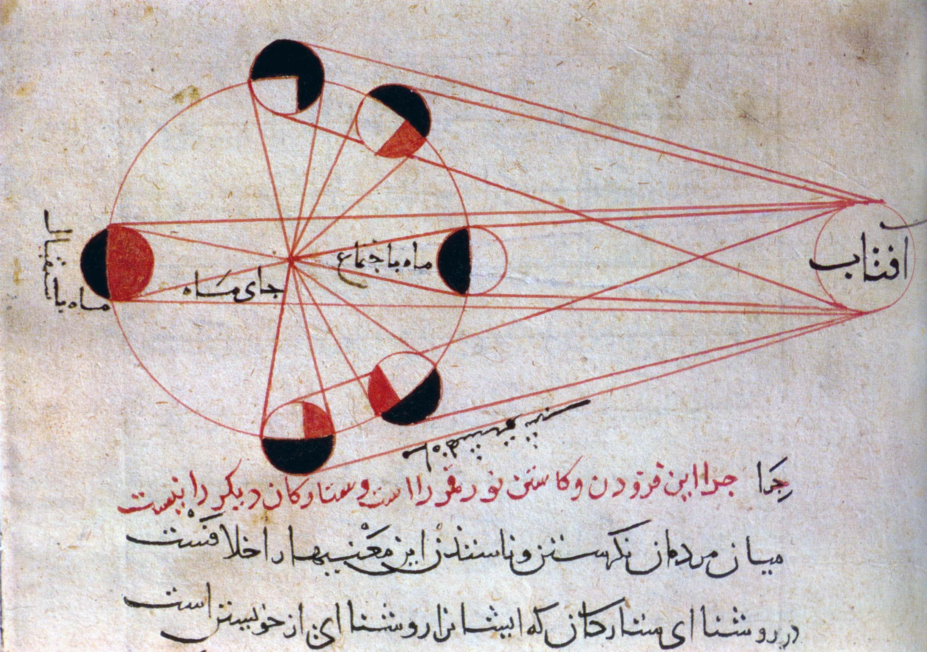
Middle Eastern culture was influenced by the works of Aristotle and the philosophy of empiricism. They continued to make significant advances in mathematics, astronomy, and medicine throughout the middle ages.
Al-Biruni’s Phases of the Moon (c. 973 – 1050 CE)
Abū Rayḥān Muḥammad ibn Aḥmad Al-Bīrūnī was an Iranian scholar and polymath.

Slide 15

Sadly, most of the scientific advances of the Greeks were forgotten in Europe after the fall of Rome, and European culture entered what is sometimes known as “The Dark Ages”.

Slide 16
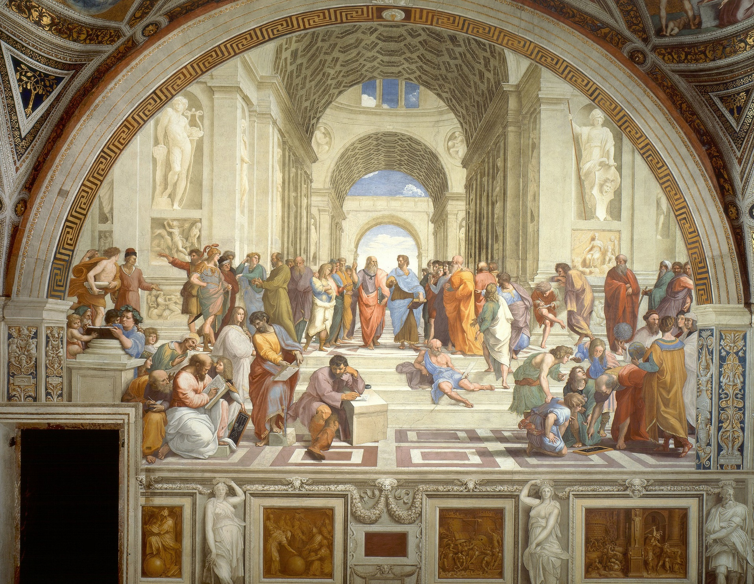
In the 12th century, European scholars became exposed to the knowledge and culture preserved and cultivated in the Middle East, and Europe re-emerged from the Dark Ages in a period known as the Renaissance.
The School of Athens (c. 1511 CE)
Painting by Raffaello Sanzio da Urbino depicting a number of Greek philosophers, including Plato and Aristotle.

Slide 17
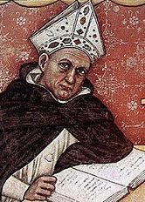
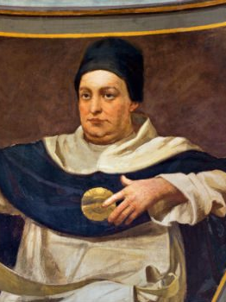
Scholasticism
One of the primary schools of medieval philosophy. Scholasticism attempted to reconcile the philosophies of the ancient philosophers with medieval religious beliefs.
It relied heavily on presupposed dogma and tradition.
Albertus Magnus
(1193 – 1250 CE)
Thomas Aquinas
(1225 – 1274 CE)

Slide 18
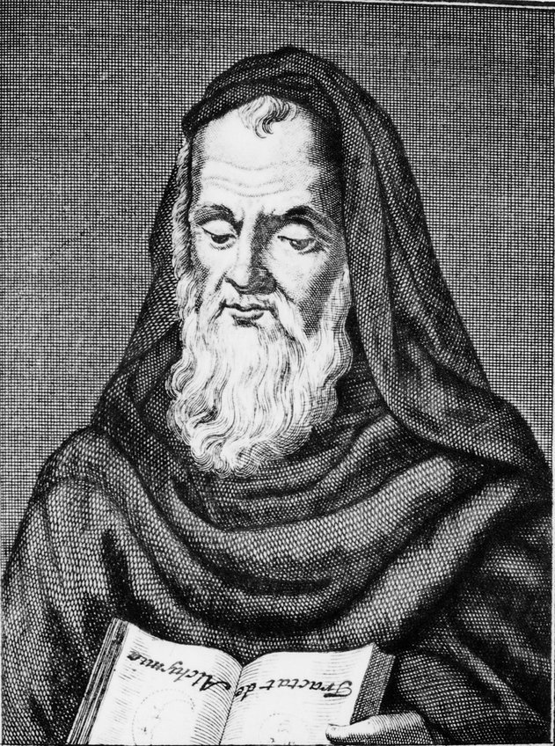
Roger Bacon was an English Franciscan friar, philosopher, scientist, and scholar who called for an end to blind acceptance of widely accepted writings.
He was particularly critical of Aristotle’s ideas, which, while valuable, were often accepted as face even in the face of evidence which did not support them.
Roger Bacon
(1210 – 1293 CE)

Slide 19
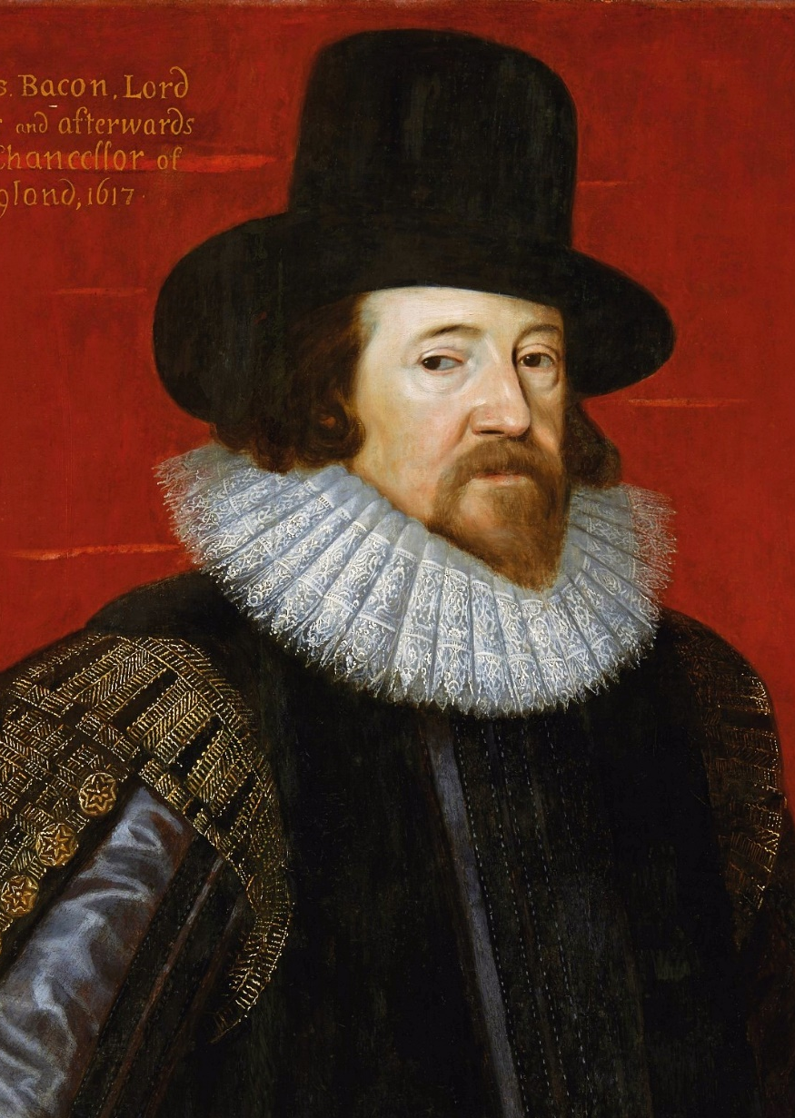
Inductivism
A philosophy in which one observes natural phenomena, proposes a law to generalize an observed pattern, and confirms this law through observation.
If the law continues to be upheld, one progressively proposes broader laws as more observations allow.
(Proposed by Francis Bacon, c. 1620 CE)
Francis Bacon
(1561 – 1626 CE)

Slide 20



The Limitations of Induction
Suppose that you propose a new natural law:
“There is no such thing as a blue apple.”
Exhibit A:
Exhibit B:
Exhibit C:
No matter how many non-blue apples you show me, I can always claim that a blue apple exists, somewhere.

Slide 21
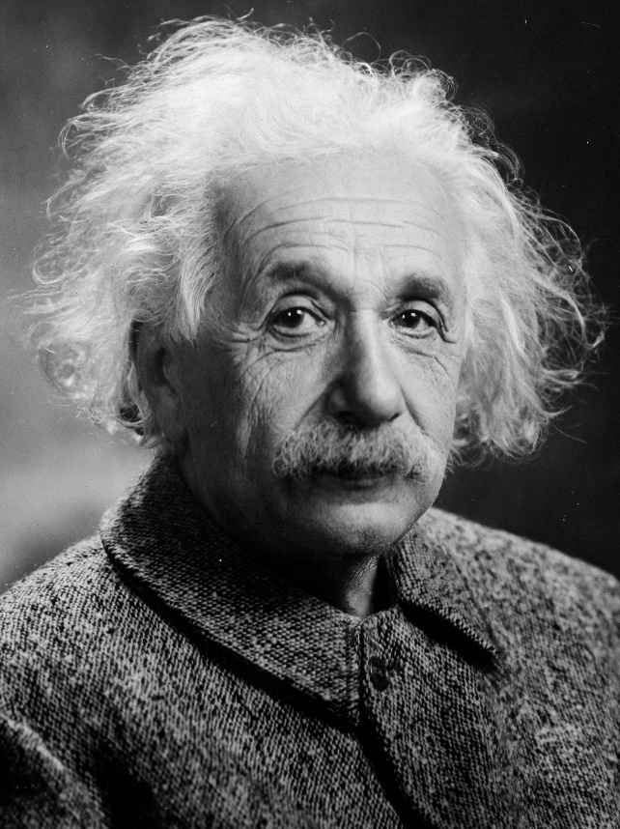

“No amount of experimentation can ever prove me right; a single experiment can prove me wrong.”
- Albert Einstein

Slide 22
The Modern Scientific Method
Hypothetico-Deductivism
Scientific inquiry proceeds by formulating a hypothesis, then making a prediction based on that model which could be conceivably falsified through observable data.
This prediction is then tested through experiment, and stands as long as experiment continues to confirm its predictions.
In this model, there are no natural laws – only theories which have not yet been disproven.

Slide 23
The Scientific Method
Make an Observation
Develop General Theories
Ask Questions
Refine, alter, expand, or reject hypothesis.
Experiment / Gather Data
Hypothesize
Make Testable Predictions
Why do we always run experiments more than once?

Slide 24

All of these plants were grown in the same soil, under the same light, with the same watering schedule, for the same amount of time.
Why are some taller than the others? Was there a variable that wasn’t accounted for?

Slide 25
Random variation is variability in a complex system due to many irregular and erratic fluctuations or chance factors.
Unlike error, which results from a variable which was not controlled, random variation results from variables which can not be controlled.

Slide 26
Independent Variable
Dependent Variable
– A factor which isn’t affected by any other variables in the experiment.
Independent variables are typically something which you control.
– A factor which is affected by other variables in the experiment.
Dependent variables are typically something which you measure.

Slide 27
Independent Variable
Dependent Variable
– A factor which isn’t affected by any other variables in the experiment.
Independent variables are typically something which you control.
– A factor which is affected by other variables in the experiment.
Dependent variables are typically something which you measure.
Controlled Variable
Experimental Variable
An independent variable which is purposefully kept constant throughout an experiment.
An independent variable which you change in order to test your hypothesis.

Slide 28
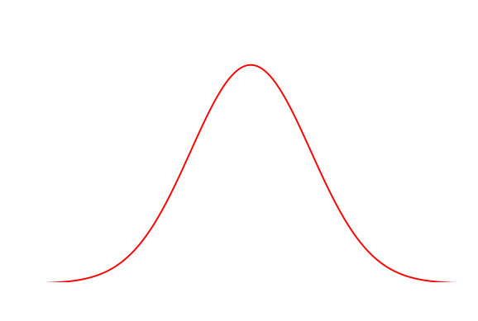
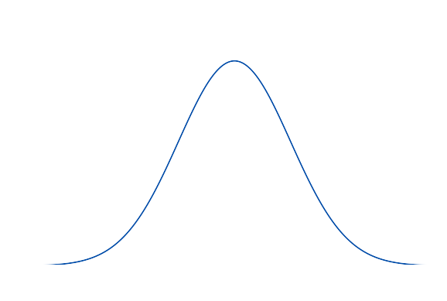
Accounting For Random Variation
Real-world data does not exist at a single value…
Random variation creates a distribution of values for a given set of conditions.
Probability
Height
Group A
Group B
Statistics gives us the mathematical language we need to determine whether the data we have obtained can be trusted, or contains too much randomness to be certain of the outcome.

Slide 29

Next time…
Why is some science not “good” science?

